Slide 1
Model-View-Controller Pattern

Slide 2
Model-View-Controller Overview
A program can often be divided into two parts:
"Model": the internal working "guts" of the program where the processing actually takes place.
"View": the input and output of the program which interacts with the user.
The view takes the user input and passes the information onto the model. The model outputs information to the view, which then presents it to the user.

Slide 3
Model-View-Controller Overview
In the spirit of "loose coupling" the following ideals should be enforced:
The model should operate independently from the manner in which the view interacts with the user.
The view should be tailored to meet the interaction needs of the user, independent of the model below it.
A model should work with a number of different views.
Therefore, what we need is one more component, the "Controller": "knows" about both the specific model and specific view being used.
The controller's job is: Takes user input from view and figures out what it means to the model.

Slide 4
Model-View-Controller architecture
The Model-View-Controller ("MVC") design pattern decouples the model from its view, enabling loose coupling and the ability to change one without affecting the other.
MVC separates each application into three types of component
models for maintaining application data and behaviors
views for displaying all or a portion of the data,
controllers for handling events that affect the model or view(s).

Slide 5
The model
Holds all the data, state and application logic.
It is built with no necessary concern for how it will "look and feel" when presented to the user.
It has a purely functional interface, meaning that it has a set of public functions that can be used to achieve all of its functionality.

Slide 6
Views
Provides graphical user interface (GUI) components for a model and presentation of information to the user.
The view retrieves data from the model and updates its presentations when data has been changed in one of the other views.
When a user manipulates a view of a model, the view informs a controller of the desired change.

Slide 7
Controllers
Translates interactions with the view into actions to be performed by the model.
In a stand-alone GUI client, user interactions could be button clicks or menu selections,
The actions performed by the model include activating business processes or changing the state of the model.
Based on the user interactions and the outcome of the model actions, the controller responds by selecting an appropriate view.
These may cause changes to the information and in turn trigger updates in all the views ensuring that they are all up to date.

Slide 8
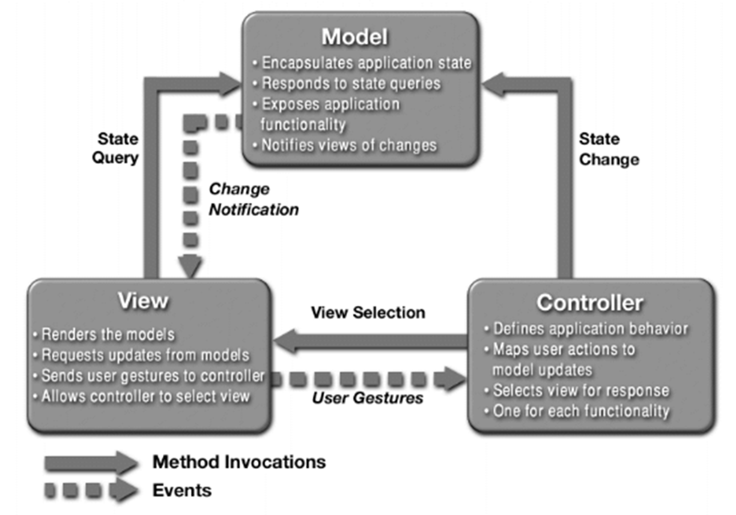
MVC pattern: How It Works

Slide 9
Implement MVC pattern

Slide 10
Simple MVC
In general, in order for a model and view to communicate, an "adapter" object is needed to translate the output of one into the input of the other.
The controller's job is:
To instantiate both the model and the view.
To instantiate the adapter(s) used to communicate between the model and view.
To establish the connections between the adapter and the view and between the adapter and the model.

Slide 11
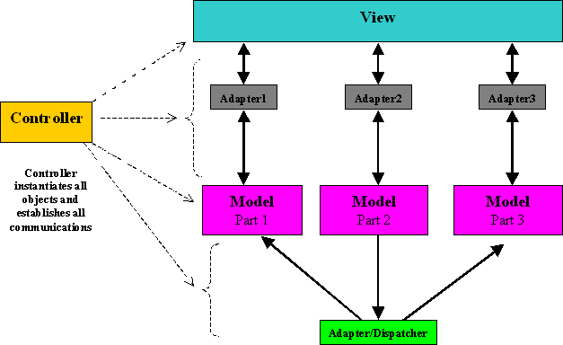
Simple MVC using Adapter

Slide 12
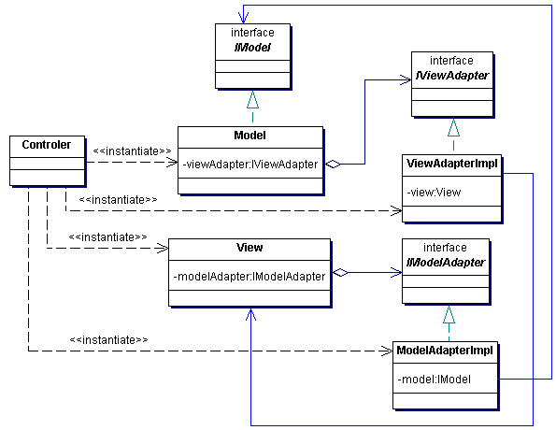
Simple MVC using Adapter

Slide 13

Simple MVC Example
Problem
Your cousin Pierre has invited you to spend two weeks with his family in Paris, France. Before you leave, however, he warns you: "It's 35 degrees here!" Remembering that France measures temperatures in degrees Celsius, you frown... Does Pierre want you to pack your winter coat or your bathing suit?
Converting Celsius to Fahrenheit and Back
public double convertFtoC(double degreesFahrenheit) { return (degreesFahrenheit - 32.0) / 9.0 * 5.0; }
public double convertCtoF(double degreesCelsius) { return degreesCelsius / 5.0 * 9.0 + 32.0; }

Slide 14
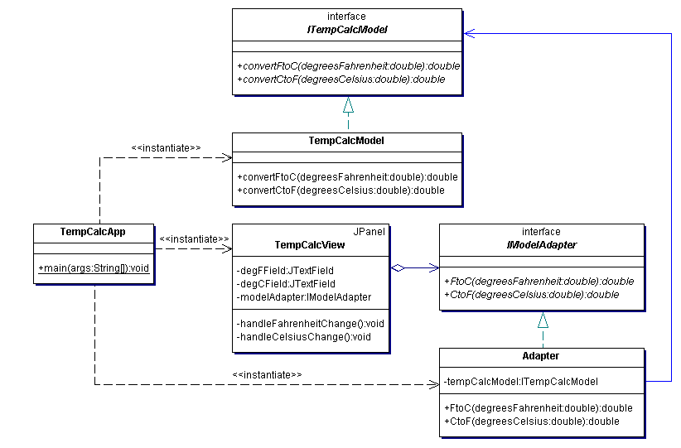
Class Diagram

Slide 15
Implement TemCalcModel
public interface ITempCalcModel {
double convertFtoC(double degreesFahrenheit);
double convertCtoF(double degreesCelsius);
}
public class TempCalcModel implements ITempCalcModel {
public double convertFtoC(double degreesFahrenheit) {
return (degreesFahrenheit - 32.0) / 9.0 * 5.0;
}
public double convertCtoF(double degreesCelsius) {
return degreesCelsius / 5.0 * 9.0 + 32.0;
}
}

Slide 16
Implement Adater
public interface IModelAdapter {
double FtoC(double degreesFahrenheit);
double CtoF(double degreesCelsius);
}
public class TempCalcApp {
public static void main(String[] args) {
final ITempCalcModel model = new TempCalcModel();
(new TempCalcView(new IModelAdapter() {
public double FtoC(double degreesFahrenheit) {
return model.convertFtoC(degreesFahrenheit);
}
public double CtoF(double degreesCelsius) {
return model.convertCtoF(degreesCelsius);
}
})).setVisible(true);
}
}

Slide 17
MVC As An Aggregate Design Pattern
MVC is set of patterns together in the same design.
Model uses Observer to keep views and controllers updated on the latest state changes.
View and Controller implement a Strategy Pattern
Example: Controller is the behavior of the view and can be easily exchanged with another controller if you want different behavior.
View also uses a pattern internally to manage the windows buttons and other components of the display => the Composite Pattern

Slide 18
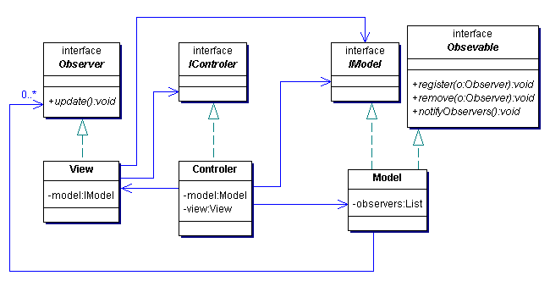
MVC pattern structure
-controler:IControler

Slide 19
MVC pattern structure
<<interface>>
<<interface>>
Observer
Observable
<<interface>>
<<interface>>
IControler
IModel
+register(o: Observer)
+update()
+removeObserver(o: Observer)
+notifyObservers()
View
Controler
Model
-controller: IController
-model: IModel
-model: IModel
-view: View
+register(o: Observer)
+update()
+removeObserver(o: Observer)
+notifyObservers()

Slide 20
MVC Example - MP3 player
Picture your favorite MP3 player (iTunes, ?)
You can use its interface to add new songs, manage play lists and rename tracks
The player maintains
Database of all your songs along with associated names and data.
Plays the song
Updates the interface constantly with current song, running time and so on
Underneath the covers --- Model View Controller

Slide 21
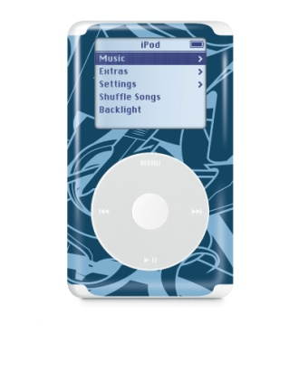
Model View Controller
The view display is updated for you.
“Play new song”
You use the interface and your actions go to the controller
You see the song display update and hear the new song playing
Controller
View
Controller manipulates the model
class Player {
play() {}
rip() {}
burn() {}
}
The model notifies the view of a change in its state.
Controller asks Player model to begin playing the song
Model
The model contains all the state, data, and application logic needed to maintain and play mp3s.

Slide 22
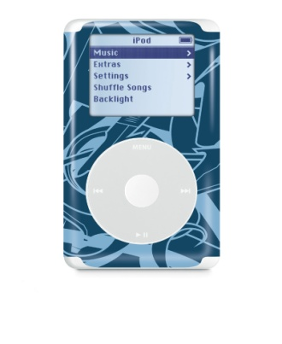
A Closer Look….
Lets see the nitty gritty details of how this MVC pattern works
VIEW:
Gives you a presentation of the model. The view usually gets the state and data it needs to display directly from the model.
CONTROLLER:
Takes user input and figures out what it means to the model.
MODEL:
The model holds all the data, state and application logic. The model is oblivious to the view and controller, although it provides an interface to manipulate and retrieve its state and it can send notifications of state changes to the Observer.
Controller
(1) The user did something
(2) Change your state
class Player {
play() {}
rip() {}
burn() {}
}
(3) Change your display
(4) I have changed
View
Model
(5) I need your state information
This is the user interface
handles all application data and logic.
Notes:
(1) You are the user -- you interact with the view
The view is your window to the model. When you do something to the view (like click the Play button), then the view tells the controller what you did. It’s the controller’s job to handle that.
(2) The controller asks the model to change its state
The controller takes your actions and interprets them. the controller figure out what that means and how the model should be manipulated based on that action.
(3) The controller may also ask the view to change
When the controller receives an action from the view, it may need to tell the view to change as a result. Ex, enable or disable certain buttons or menu items in the interface.
(4) The model notifies the view when its state has changed.
When something changes in the model, based on either some action you took, the model notifies the view that its state has changed.
(5) The view asks the model for state
The view gets the state it displays directly from the model. For instance, when the model notifies the view that a new song has started playing, the view requests the song name from the model and displays it.

Slide 23

Observer
Observers
All these observers will be notified whenever state changes in the model.
Observable
My state has changed
class Foo {
void bar() {
doBar();
}
}
View
Model
I’d like to register as an observer
Controller
View
The model has no dependencies on viewers or controllers!
View
Any object that’s interested in state changes in the model registers with the model as an observer.

Slide 24
Strategy
The controller is the strategy for the view -- it’s the object that knows how to handle the user actions.
The view delegates to the controller to handle the user actions.
The user did something
Controller
View
The view only worries about presentation, the controller worries about translating user input to actions on the model.
Controller
We can swap another behavior for the view by changing the controller.

Slide 25
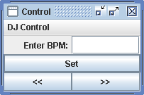

Composite
paint ()
The view is a composite of GUI components (labels, buttons, text entry, etc.).
View

Slide 26

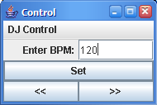
Example: Using MVC to control the beat…
Time to be a DJ and start mixing with a beat!
The Java DJ view:
A pulsing bar shows the beat in real time
A display shows the current BPMs and is automatically set whenever the BPM changes.
The view has two parts, the part for viewing the state of the model and the part for controlling things.
You can enter a specific BPM and click the Set button to set a specific beats per minute, or you can use the increase and decrease buttons for fine tuning.
Decreases the BPM by one beat per minute.
Increases the BPM by one beat per minute.

Slide 27
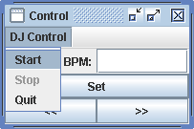
The Controller is in the middle…
The controller sits between the view and the model. It takes your input, like decreasing the BPM and turns it into an action on the model to decrease the BPM.
To control the DJView
You can start beat kicking by choosing the Start menu item in the "DJ Control" menu
All user actions are sent to the controler
Notice Stop is disable until you start the beat
The controler takes input from the user and figures out how to translate that into requests on the model
Controler

Slide 28
Lets not forget the model underneath
The BeatModel is the heart of the application. It implements the logic to start and stop the beat, set the beats per minute, and generate the sound.
on()
off()
setBPM()
getBPM()
The model also allows us to obtains its current state through the getBPM( ) method.
Beat Model

Slide 29
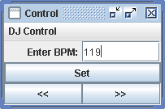

Putting the pieces together
Click on the beat increase button
… which results in the controler being invoked
View
the controler asks the model to update its BPM by one
Controller
You see the beatbar pulse every 1/2 second
Because the BPM is 120, the view gets a beat notification every 1/2 second
on()
off()
setBPM()
getBPM()
View is notified that the BPM changed. It calls getBPM() on the model state
the view is updates to 120 BPM
Beat Model

Slide 30
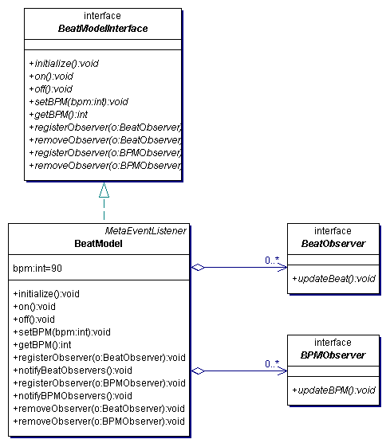
Beat Model

Slide 31
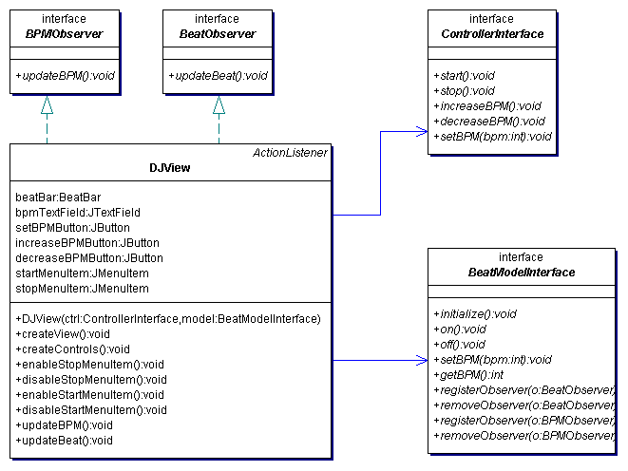
DJView

Slide 32
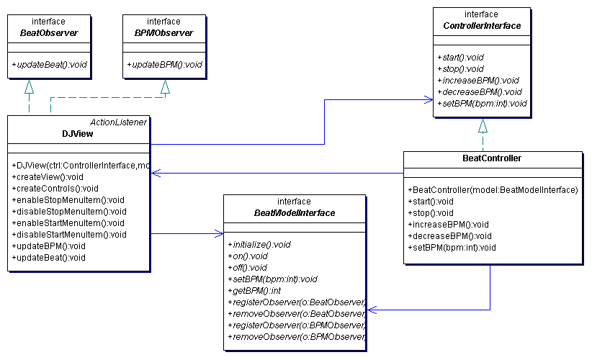
Beat Controler

Slide 33
Building the pieces
This gets called after the BeatModel is instantiated.
These methods turn the beat generator on and off.
public interface BeatModelInterface {
void initialize();
void on();
void off();
void setBPM(int bpm);
int getBPM();
void registerObserver(BeatObserver o);
void removeObserver(BeatObserver o);
void registerObserver(BPMObserver o);
void removeObserver(BPMObserver o);
}
These are the methods that a controller will use to direct the model based on user interaction.
This method sets the beats per minute. After it is called, the beat frequency changes immediately.
The getBPM() method returns the current BPMs, or 0 if the generator is off.
These methods allow the view and controller to get state and become observers.
This should look familiar, these methods allow objects to register as observers for state changes.
We’ve split this into two kinds of observers: observers that want to be notified on every beat, and observers that just want to be notified with the beats per minute changes.

Slide 34
BeatModel class….
This is needed for the MIDI code.
public class BeatModel implements BeatModelInterface, MetaEventListener {
Sequencer sequencer;
ArrayList beatObservers = new ArrayList();
ArrayList bpmObservers = new ArrayList();
int bpm = 90;
// other instance variables
public void initialize() {
setUpMidi();
buildTrackAndStart();
}
public void on() {
sequencer.start();
setBPM(90);
}
public void off() {
setBPM(0);
sequencer.stop();
}
public void setBPM(int bpm) {
this.bpm = bpm;
sequencer.setTempoInBPM(getBPM());
notifyBPMObservers();
}
public int getBPM() {
return bpm;
}
void beatEvent() {
notifyBeatObservers ( );
}
// code to register and notify observers
// Lots of MIDI code to handle the beat.
}
The sequencer is the object that knows how to generate the real beats (that you can hear!)
The ArrayLists hold the two kinds of Observers
bpm holds the frequency of beats. Default = 90.
This method does setup for the sequencer and sets up the beat tracks for us.
The on() and off ( ) starts and shuts off the sequencer.
(1) Sets the bpm instance variable
(2) Asks the sequencer to change its beats
(3) Notifies all BPM observers that the BPM has changed.
The beatEvent() method, which is not in the BeatModelInterface, is called by the MIDI code whenever a new beat starts. This notifies all BeatObservers that a new beat has just occurred.
34

Slide 35
The view

Slide 36
Implementing the View (just an outline!)
public class DJView implements ActionListener, BeatObserver, BPMObserver {
BeatModelInterface model;
ControllerInterface controller;
JFrame viewFrame;
JPanel viewPanel;
BeatBar beatBar;
JLabel bpmOutputLabel;
public DJView(ControllerInterface controller, BeatModelInterface model) {
this.controller = controller;
this.model = model;
model.registerObserver((BeatObserver) this);
model.registerObserver((BPMObserver) this);
}
public void createView() {
// create all Swing components here
}
public void updateBPM() {
int bpm = model.getBPM();
if (bpm == 0) {
bpmOutputLabel.setText("offline");
} else {
bpmOutputLabel.setText("Current BPM: " + model.getBPM());
}
}
public void updateBeat() {
beatBar.setValue(100);
}
}
DJView is an observer for both the real-time beats and BPM changes.
The view holds a reference to both the model and the controller.
The updateBPM() method is called when a state change occurs in the model. When that happens we update the display with the current BPM. We can get this value by requesting it directly from the model.
Likewise, the updateBeat() method is called when the model starts a new beat. When that happens, we need to pulse our “beatbar”. We do this by setting it to its maximum value and letting it handle the animation of the pulse.

Slide 37
The DJView continued…
public class DJView implements ActionListener, BeatObserver, BPMObserver {
BeatModelInterface model;
ControllerInterface controller;
Jlabel bpmLabel;
JTextField bpmTextField;
Jbutton setBPMButton, increaseBPMButton, decreaseBPMButton;
JMenuBar menuBar;
Jmenu menu;
JMenuItem startMenuItem, stopMenuItem;
public void createControls() {
// create all Swing components
}
public void actionPerformed(ActionEvent event) {
if (event.getSource() == setBPMButton) {
int bpm = Integer.parseInt(bpmTextField.getText());
controller.setBPM(bpm);
} else if (event.getSource() == increaseBPMButton) {
controller.increaseBPM();
} else if (event.getSource() == decreaseBPMButton) {
controller.decreaseBPM();
}
}
public void enableStopMenuItem ( ){
stopMenuItem.setEnabled(true);
}
public void disableStopMenuItem ( ){
stopMenuItem.setDisabled (true);
}
}
This method is called when a button is clicked.
If the Set button is clicked then it is passed on to the controller along with the new bpm.
Likewise if increase or decrease buttons are clicked, this information is passed on to the controller.

Slide 38
Now for the Controller….
Remember - the controller is the strategy that we plug into the view.
What does a Strategy pattern look like? What do we need?
public interface ControllerInterface {
void start();
void stop();
void increaseBPM();
void decreaseBPM();
void setBPM(int bpm);
}
Here are all the methods that a view can call on the controller
These should all look familiar after seeing the model’s interface. You can start and stop the beat generation, and change the BPM. This interface is “richer” than the BeatModel interface because you can adjust the BPMs with increase and decrease.

Slide 39
The Controller
public class BeatController implements ControllerInterface {
BeatModelInterface model;
DJView view;
public BeatController(BeatModelInterface model) {
this.model = model;
view = new DJView(this, model);
view.createView();
view.createControls();
view.disableStopMenuItem();
view.enableStartMenuItem();
model.initialize();
}
public void start() {
model.on();
view.disableStartMenuItem();
view.enableStopMenuItem();
}
public void stop() {
model.off();
view.disableStopMenuItem();
view.enableStartMenuItem();
}
public void increaseBPM() {
int bpm = model.getBPM();
model.setBPM(bpm + 1);
}
public void decreaseBPM() {
int bpm = model.getBPM();
model.setBPM(bpm - 1);
}
public void setBPM(int bpm) {
model.setBPM(bpm);
}
}
The controller gets to hold on to the view and the model and glues it all together.
The controller is passed the model in the constructor and then creates the view.
When you choose Start from the user interface menu, the controller turns the model on and then alters the user interface to that the start menu item is disabled and the stop menu item is enabled.
Note: the controller is making the intelligent decision for the view.
The view just knows how to turn menu items on and off; it doesn’t know the situations in which it should disable or enable them.
39

Slide 40
Putting it all together…
First create the model…
public class DJTestDrive {
public static void main(String[] args) {
BeatModelInterface model = new BeatModel();
ControllerInterface controller = new BeatController(model);
}
}
…then create a controller and pass it the model. Remember, the controller creates the view, so we don’t have to do that.

Slide 41
Summary
The MVC Pattern is a compound pattern consisting of the Observer, Strategy and Composite patterns.
The model makes use of the Observer pattern so that it can keep observers updated, yet stay decoupled from them.
The controller is the strategy for the view. The view can use different implementations of the controller to get different behavior.
The view uses Composite Pattern to implement the user interface, which usually consists of nested components like panels, frames, and buttons.
These patterns work together to decouple the three players in the MVC model, which keeps designs clear and flexible.
The Adapter pattern can be used to adapt a new model to an existing view and controller.

